Slide 1
CSE 170 Technical Teamwork
Week 7 Commitment Day 1
Bro Clements

Slide 2
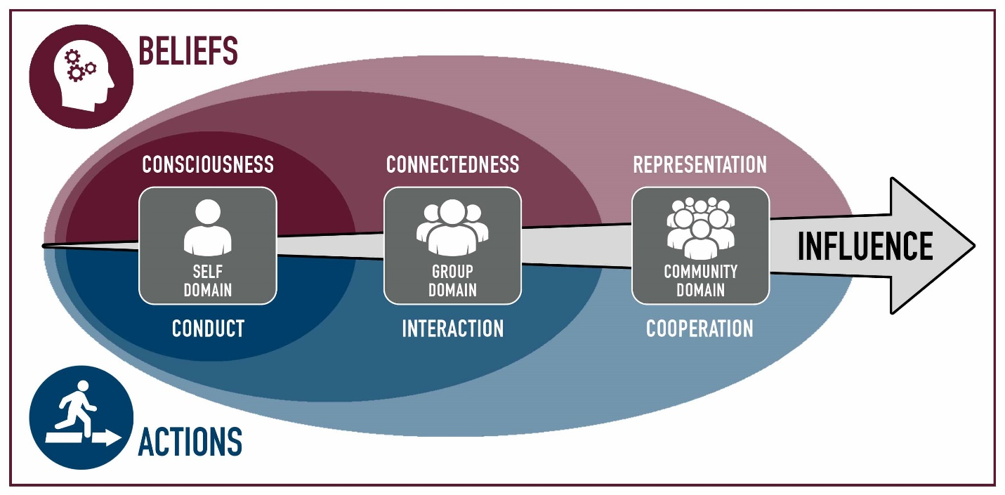
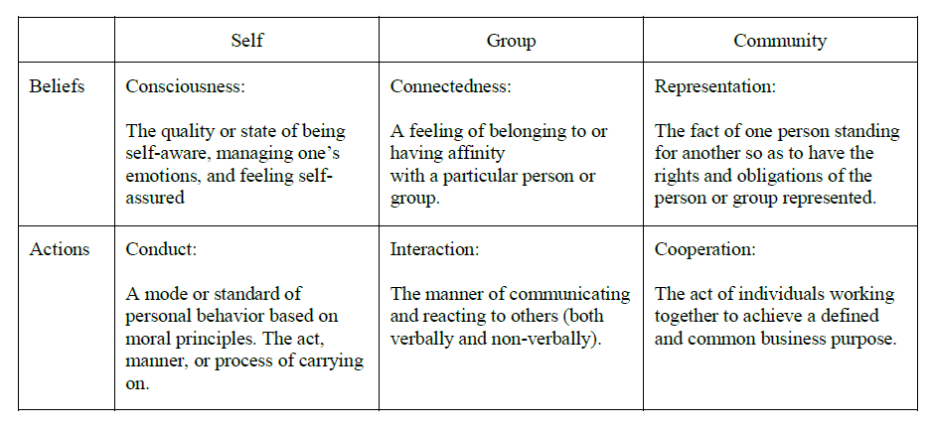
Commitment, Estimation, Stewardship
 | Module | Domain | Competency
1 | Teamwork
2 | Influence
3 | Personality | Self | Consciousness
4 | Motivation | Self | Consciousness
5 | Professionalism | Self | Conduct
6 | Pressure | Self | Conduct
7 | Commitment | Group | Connectedness
8 | Conflict | Group | Connectedness
9 | Integrity, Trust & Honesty | Group | Interaction
10 | Communication | Group | Interaction
11 | Leadership | Community | Representation
12 | Loyalty | Community | Representation
13 | Cooperation | Community | Cooperation
14 | Synergism | Community | Cooperation
Why is commitment so hard?
Why is estimation hard?
Why is stewardship hard?

Slide 3
Coming Up
Acorn Project – 7 & 8
Week 06 Group assignments
Week 07 Proposal Due
Week 08 Approval Due
Week 09 Either 1 of 4 done or 25% of each done
Week 10 Either 2 of 4 done or 50% of each done
Week 11 Either 3 of 4 done or 75% of each done
Week 12 Project Due
Week 13 Project Presentations
Beginning with the end in mind – S.R. Covey

Slide 4


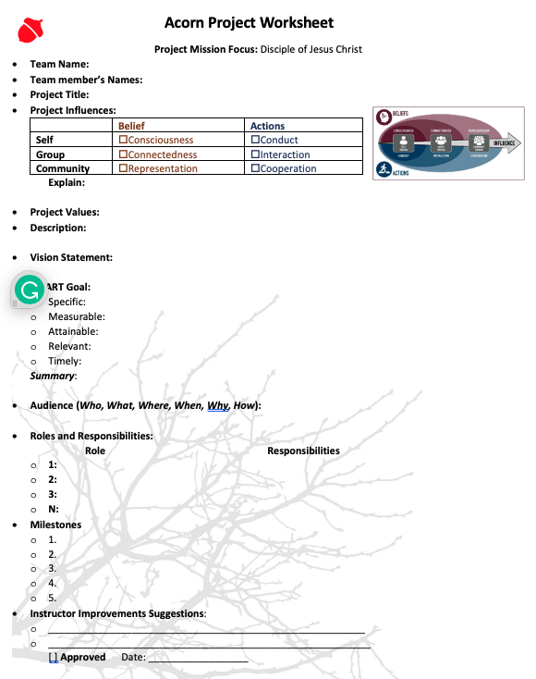




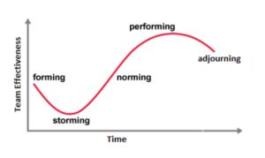

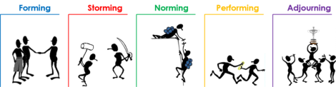
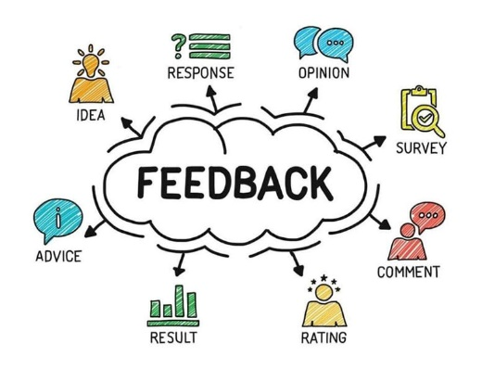





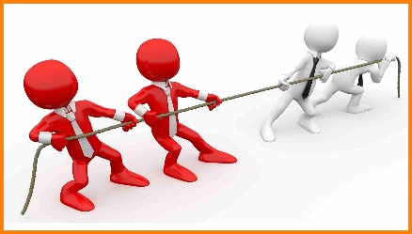


Acorn Project Proposal
Turn in the last 4 pages of the workbook.

Slide 5
Goal: Each of the ILO
Matches to CLO
Would like to see
Service project
Use of Academic Service
Personal Growth/Learning
Involvement in Society or Initiative
Fun!!
Milestones
3-4 Gathering per goal
i.e.
Planning, Gathering, Practice, Conclusion
3-course meal
Multiple sessions
 | Module | Domain | Competency
1 | Teamwork
2 | Influence
3 | Personality | Self | Consciousness
4 | Motivation | Self | Consciousness
5 | Professionalism | Self | Conduct
6 | Pressure | Self | Conduct
7 | Commitment | Group | Connectedness
8 | Conflict | Group | Connectedness
9 | Integrity, Trust & Honesty | Group | Interaction
10 | Communication | Group | Interaction
11 | Leadership | Community | Representation
12 | Loyalty | Community | Representation
13 | Cooperation | Community | Cooperation
14 | Synergism | Community | Cooperation

Slide 6
Ideas
Attend a Career Services event as a team and work on a deliverable
Ropes Course
Mentoring Certificate
Participate in “Get Involved”: Recreation, Ushering, Get Connected, I-Serve, Peer Mentoring, Rep Council, Tutoring
Participate in a service project, service information, training that will help other students at BYU-Idaho.
Attend a Society Event such as a Hack-A-Thon, participate as a team
Join a Department Society and work together to contribute to a project
Create a program together, use a collaborative tool and resource repository.
Participate in a Sport, Sporting Event, or Team activity
Attend a Leadership conference/activity produced by Student Services
Participate in an Escape Room, Rope Course, or similar activity
Discover 4+ campus building activities: for example Geology, Animal, Garden tour, Planetarium
Plan three group date, with at least 3 activities
Play 5 different players vs the board, 2-3 times, or an RPG game

Slide 7

Phillip Walker Overview
Software Designer – Sr, 15 yrs
Background: Emily (H.S. Sweetheart, 2 children)
Industry: Health Care
Company: Mercy Health Groups, customer 19 hospitals
Project: MyCare, Request overtime in the past,
Customer Expectation: Six months vs Reality: 9 months
Next 5 minutes – re-read Walker’s story

Slide 8
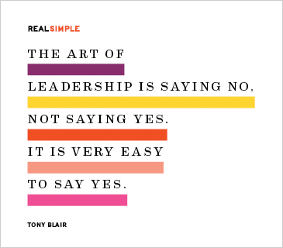
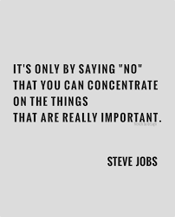

Saying No “What does it mean when you say no?”
How do you say no to your boss?
Find the goal, and negotiate
Higher the stakes, the more valuable ‘No’ becomes
Give the best information
Team player: difference between stubborn and not possible
Team player is not someone who says “yes” all the time
Being the hero is not a professional
Risk Mitigation

Slide 9
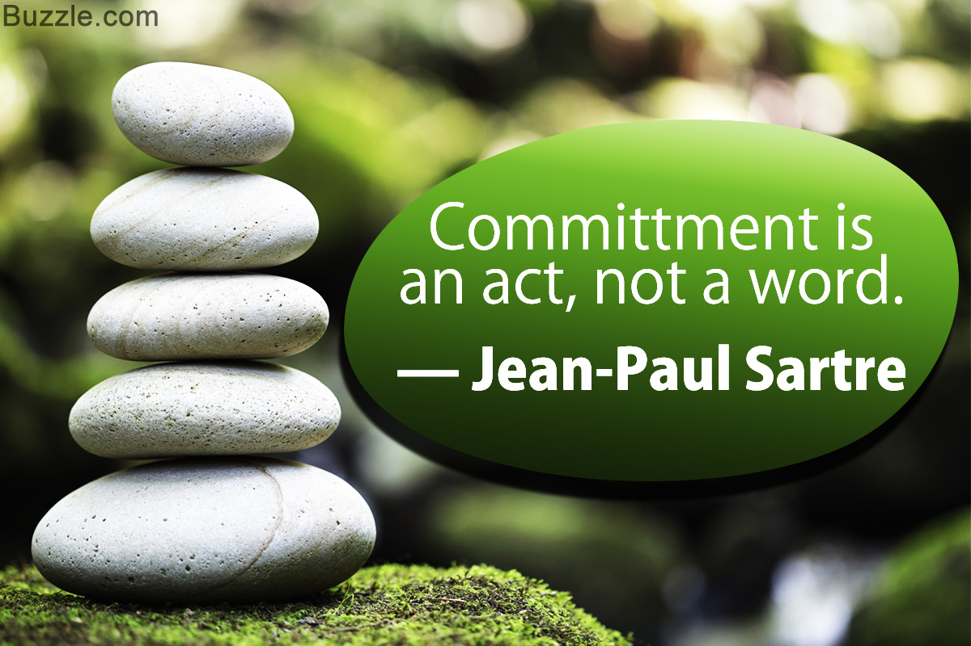
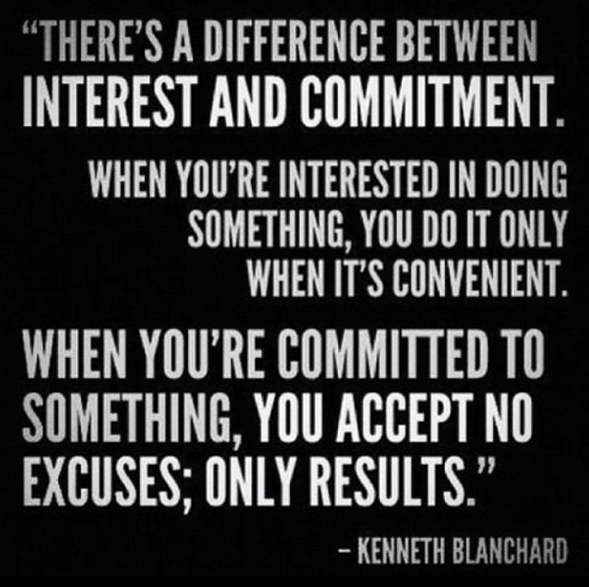
Saying Yes “What does it say when you say yes?”
Commitment – Say-Mean=Do
Say you’ll do it
You mean it
You actually do it
Noncommitment Phrases: Need/Should, Hope/Wish, Let’s
Commitment: “I will…by…”
Understand the dependency
Understand what you don’t know
Understand Murphy, Hofstadters, Parkinson Laws
Hofstadter’s law states that it always takes longer than you expect, even when you take into account Hofstadter’s Law
Parkinson’s law states that work expands so as to fill the time available for its completion.

Slide 10
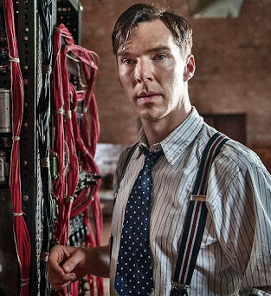
Phillip - Confrontation
Confrontation
What objectives are Phillip and Ryan each pursuing?
Are some of these conflicting? Do you think that is a problem?
What is their professional responsibility toward each other?
Decision poll: say "yes" or say "no"
Commitment
What are the different ways Phillip can respond to Ryan?
Which of these do you think are better than the others and why?
What does a professional mean when they make a commitment?
The Decision
What factors should Phillip consider in making his decision?
What are the ramifications of saying “yes” or agreeing?
What are the ramifications of saying “no” or disagreeing?
Decision poll: say "yes" or say "no"
Confrontations (Problems/Risks) | Commitment/Response | Decision (Factors)

Slide 11
Day 2 – Commitment and Estimation

Slide 12
How good are you at estimating?
Without looking up the information…
Surface temperature of the Sun
Latitude of Shanghai
Area of the Asian continent
The year Alexander the Great’s birth
Total value of the U.S. Currency in circulation in 2004
Total volume of the Great Lakes
Worldwide box office receipts of the movie Titanic?
Total length of the coastline of the Pacific Ocean?
Number of book titles published in the U.S. since 1776?
Heaviest blue whale ever recorded?

Slide 13
Boris Ball Point Game
15 minutes
Purpose: To identify spiral development outside of software, and each iteration bring improvement or lessons learned.
Object:
The object of the game is to process the most work possible by passing balls through the pipeline.
Overview
Everyone is part of one big team.
Each ball must have air-time.
Each ball must be touched at least once by every team member.
Balls cannot be passed to your direct neighbor to your immediate left or right.
Each ball must return to the same person who introduced it into the system – counts as a point.
When a ball drops on the floor it is out of play for the entire 5 iterations (defect/resource lose)
Game Play:
There will be 5 iterations of 2 minutes each, followed by 1 minute retrospective & planning.
Each Iteration
Estimate ball returns (product)
Work for 2 minutes
A complete circuit with one ball is worth one point.
Plan & Objectives and next iteration planning is 1 minute
Lessons Learned:
What is the productive? Of each member?
What made the most improvement? Was there lose in productivity? %?
Iteration | Estimate Points | Actual | Change
1
2
3
4
5

Slide 14
Estimations are Hard Why?
Story:
The account manager explained roughly what the client was looking for, we talked it out, and I said, “That should be about 3 weeks of work.” “Sounds good,” he said. And so I got to coding.
Actually: 3 months
I resolved to Never Be That Wrong Again…I’m always that wrong
writing software involves figuring out something in such incredibly precise detail that you can tell a computer how to do it. The problem is that there are often problems hidden in the parts you don’t fully understand that explode and just utterly screw you.
Every programmer who’s been working in the real world for more than a few months has run into the problems I’m describing above.
The key is that you first accept that making accurate long-term estimates is fundamentally impossible.

Slide 15
Coding, Fast and Slow: Developers and the Psychology of Overconfidence
writing software involves figuring out something in such incredibly precise detail that you can tell a computer how to do it. The problem is that there are often problems hidden in the parts you don’t fully understand that explode and just utterly screw you.

Slide 16

Coding, Fast and Slow: Developers and the Psychology of Overconfidence
Story
Why You Suck at Making Estimates, Part I:
Writing Software = Learning Something You Don’t Know When You Start
Why You Suck at Making Estimates, Part II:
Overconfidence
What It Feels Like To Be Wrong: Systems I & II, and
The 3 Weeks and 3 Months Problem
Alright, So Let’s Stop Being So Overconfident!
When Experts Are Right, and How To Use That To Your Advantage
Wait, Wait, Wait, Let’s Just Make a Thousand 4 Hour Estimates!
Are We All Just Screwed?

Slide 17
Coding, Fast and Slow: Developers and the Psychology of Overconfidence
But first, a story.
It was the <insert time period that will not make me seem absurdly old>, and I was a young developer. In college, I aced my coding exercises. As a junior dev, I had cranked out code to solve whatever problems someone specified for me quicker than anyone expected. I could learn a new language and become productive in it over a weekend (or, so I believed).
And thus, in the natural course of things, I got to run my own project. The account manager explained roughly what the client was looking for, we talked it out, and I said, “That should be about 3 weeks of work.” “Sounds good,” he said. And so I got to coding.
How long do you imagine this project took? Four weeks? Maybe five?
Um, actually: three months.
I have vivid memories of that time — my self-image had been wrapped up in being “a good programmer” and here I was just hideously failing. I lost sleep. I had these little panic attack episodes. And it just Would. Not. End. I remember talking to that account manager, a pit in my stomach, explaining over and over that I still didn’t have anything to show.
During one of those black periods, I resolved to Never Be That Wrong Again.
Unfortunately, over the course of my career, I’ve learned something pretty hard: I’m always that wrong.
Actually, I’ve learned something even better: we’re all that wrong.

Slide 18
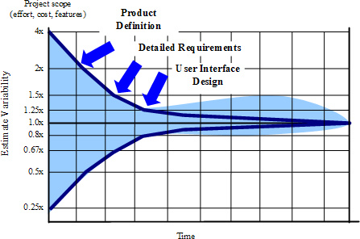
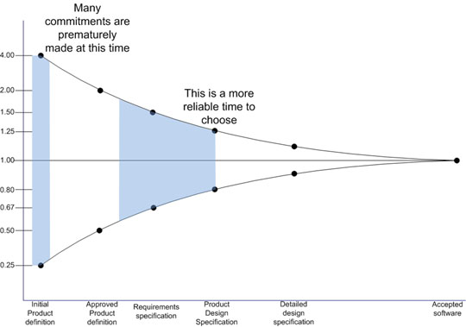
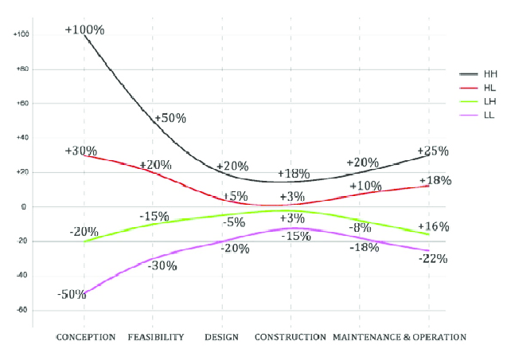
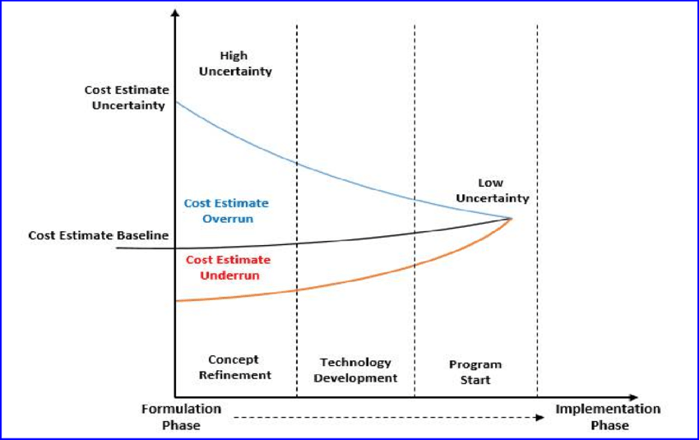
Coding, Fast and Slow: Developers and the Psychology of Overconfidence
Why You Suck at Making Estimates, Part I: Writing Software = Learning Something You Don’t Know When You Start
Writing software involves figuring out something in such incredibly precise detail that you can tell a computer how to do it. The problem is that there are often problems hidden in the parts you don’t fully understand that explode and just utterly screw you.
Every programmer who’s been working in the real world for more than a few months has run into the problems I’m describing above.
Scope Creep

Slide 19
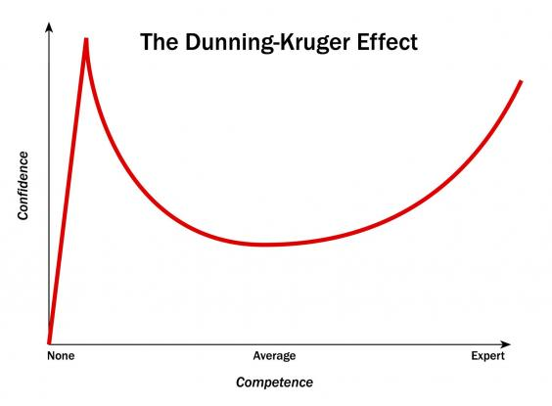
Coding, Fast and Slow: Developers and the Psychology of Overconfidence
Why You Suck at Making Estimates, Part II: Overconfidence
System I and System II.
My far-too-brief summary would be “System I does quick, heuristic, pattern matching thinking and
System II does careful, rational, analytical thinking.”
How long does it take?
Estimation
Scotty (4) vs Mine(pi)
(For those playing along at home: my “3-week” projects seem to take 5–15 weeks, my “3-month” projects usually take 1–3 years, on the rare event that someone is willing to keep paying me).

Slide 20
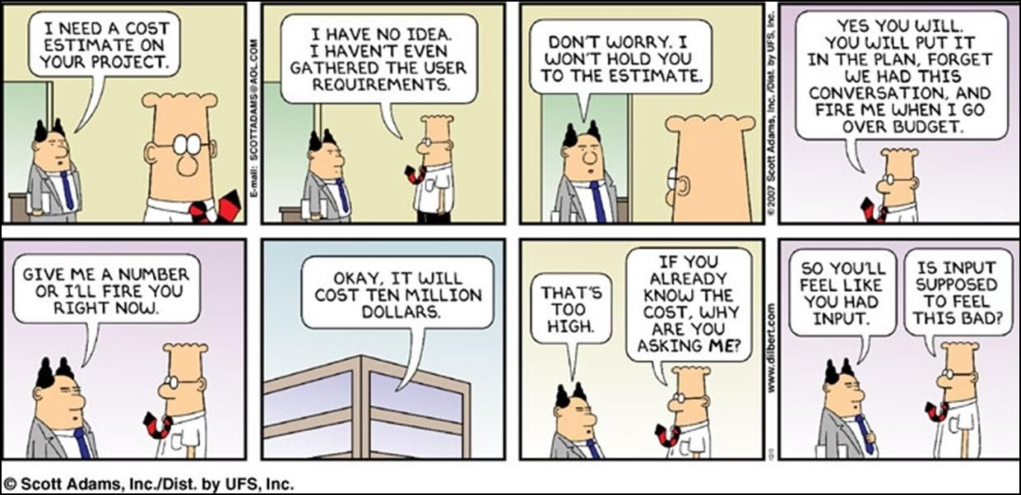
My story: What is your status?
Unrealistic Manager
Two weeks into a new project and company…
Manager: So, when do you think you are going to be done with your project?
I don’t know, I just start last week
I don’t know the project, product, libraries, and unfamiliar with code base.
Manager: You are a professional, make a guess.
Let’s see, a project of this size, if I was to guess optimistically based on my history with this type of scenario, 6 months.
Manager: Can’t do that, this 3-month project is 2 months behind schedule, can you get it done by the end of this month?
Um, why did you ask my opinion

Slide 21
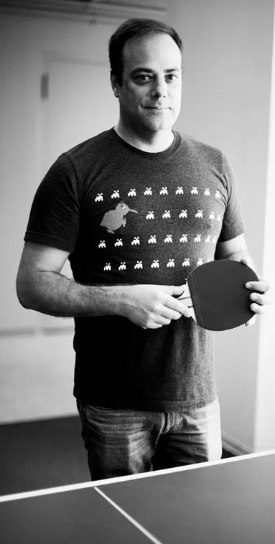

Painless SW Schedules
JoelOnSoftware – author of Stackoverflow
Use something (Excel), it is better than nothing
Keep it Simple, to track each feature
Estimate must come from the programmer, not the manager (separate column)
Fine grain, to the hour, not days.
Keep track of the estimate and the actual
Actual increment by hours worked
Estimated time is not Calendar time, wood blocks
Debug time buffer, Integration, general buffer

Slide 22
Coding, Fast and Slow: Developers and the Psychology of Overconfidence
Alright, So Let’s Stop Being So Overconfident!
You might be thinking at this point: “Okay, I see where Dan is going: we have to approach these estimation challenges in some manner that engages System II instead of System I. That way, our careful, analytical minds will produce much better estimates.”
Congratulations, you’ve just invented Waterfall (estimation).
The real trouble here is the interplay between the two sources of estimation error:
the human bias towards overconfidence, and
the inherent uncertainty involved in any real software project.

Slide 23

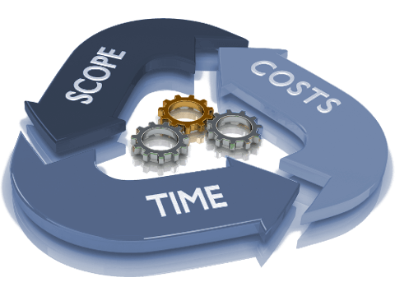
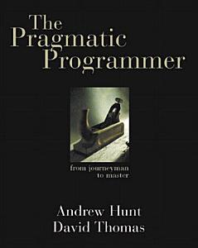
Estimating
From Pragmatic Programmer
Tip 23: Estimate to Avoid Surprises
How Accurate Is Accurate Enough?
Where Do Estimates Come From?
Understand What’s Being Asked
Build a Model of the System
Break the Model into Components
Give Each Parameter a Value
Calculate the Answers
Keep Track of Your Estimating Prowess
Program Evaluation Review Technique, or PERT: optimistic, a most likely, and a pessimistic estimate
Tip 24: Iterate the Schedule with the Code
What to Say When Asked for an Estimate: You say “I’ll get back to you.”

Slide 24
Coding, Fast and Slow: Developers and the Psychology of Overconfidence
When Experts Are Right, and How To Use That To Your Advantage
Wait, Wait, Wait, Let’s Just Make a Thousand 4 Hour Estimates!
“To know whether you can trust a particular intuitive judgment, there are two questions you should ask:
Is the environment in which the judgment is made sufficiently regular to enable predictions from the available evidence?
Do the professionals have an adequate opportunity to learn the cues and the regularities?”
If something is going to take a year or more, the feedback loop is too long to train your intuition (plus you need a lot of instances).
0–12 hour tasks which are then immediately executed
The highest-velocity team I’ve ever been on did week sprints, and broke everything down to, basically, 0, 2, 4, or 8 hours – System 1
you can make these micro-scale estimates
how on earth could something you expected to take 4 hours actually take a month or two?
all the time
they place a hard limit on the cost of a horrifically bad estimate.

Slide 25

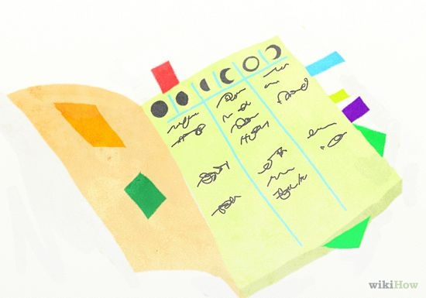
Evidence Based Scheduling
Break’er down – 1 to 16-hour blocks
Track elapsed time – Calendar and Worked time
Estimate are not perfect, and never will be, they are targets
Monte Carlo – probability of happening – range
10% of getting it in early
50% of getting it on schedule
70% of being 2 weeks late
90% of being 4 weeks late
Understand estimate vs actual and the handicap
Mange project activity, watch for scope creep, burn out (badgering for shorter estimates)

Slide 26
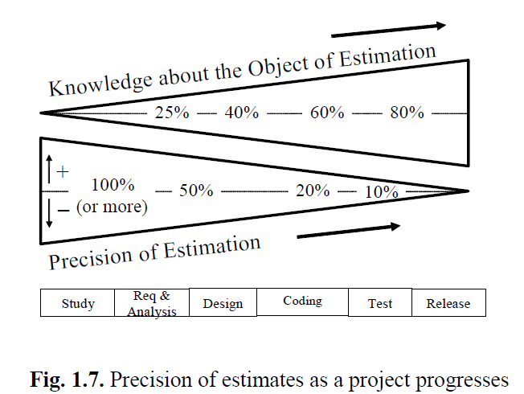
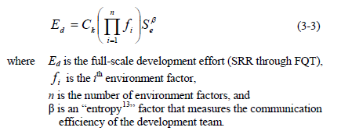
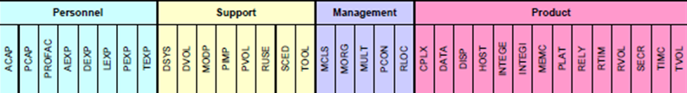

Coding, Fast and Slow: Developers and the Psychology of Overconfidence
Are We All Just Screwed?
first accept that making accurate long-term estimates is fundamentally impossible
how you can your dev team generate a ton of value, even though you can not make meaningful long-term estimates?
What we’ve arrived at is basically a first-principles explanation of why the various Agile approaches have taken over the world.

Slide 27
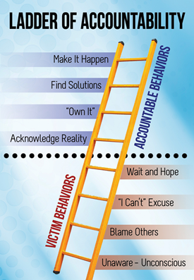
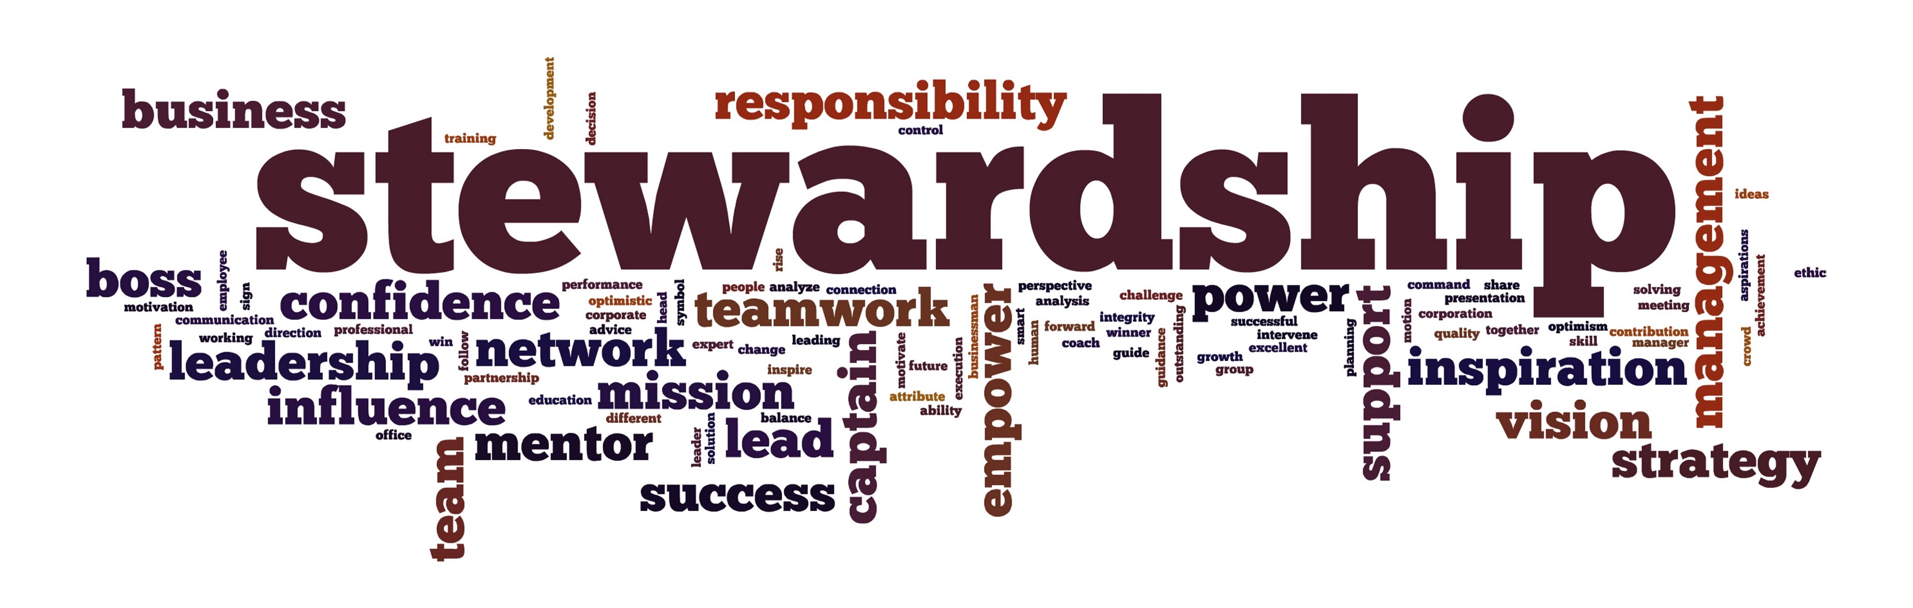
Stewardship
Accountability
Meet deadlines
Complete the circle
Chain of accountability
Buck stops with you
Polish your project
Be Organized
To do list
Take notes
Learn to focus
Rewards for Stewardship
Five A’s : Acknowledge, Author, Accomplish, Accountable, Approbation

Slide 28
How good are you at estimating?
With out looking up the information…
Surface temperature of the Sun
Latitude of Shanghai
Area of the Asian continent
The year Alexander the Great’s birth
Total value of the U.S. Currency in circulation in 2004
Total volume of the Great Lakes
Worldwide box office receipts of the movie Titanic?
Total length of the coastline of the Pacific Ocean?
Number of book titles published in the U.S. since 1776?
Heaviest blue whale ever recorded?

Slide 29
How good are you at estimating?
With out looking up the information…
Surface temperature of the Sun
Latitude of Shanghai
Area of the Asian continent
The year Alexander the Great’s birth
Total value of the U.S. Currency in circulation in 2004
Total volume of the Great Lakes
Worldwide box office receipts of the movie Titanic?
Total length of the coastline of the Pacific Ocean?
Number of book titles published in the U.S. since 1776?
Heaviest blue whale ever recorded?
10,000 F/6,000 C
31 degrees North
17,139,000 sq miles
44,390,000 sq meters
356 BC
$719.9 billion
5,500 cubic miles
$1.835 billion
84,300 miles
22 million
380,000 pounds
170 metric tons

Slide 30


